Slide 1
IMDB – Data Base Design
Section 05 – Team 07
Presenters: Vinoth , Venkatesh , Radhika
Supervisor: Prof.Richard Sherman

Slide 2
Contents
Introduction
Database
ER Model
Database Implementations
Application – Data Analysis (Tableau tool )
Conclusion

Slide 3
Introduction
Overview
Implementing the concepts of Database and Designing a Database system for an IMDB website.

Slide 4
DATA BASE COVERED
Relational Data base
A relational database (RDB) is a collective set of multiple data sets organized by tables, records and columns. RDBs establish a well-defined relationship between database tables. Tables communicate and share information, which facilitates data search, organization and reporting.
MS SQL SERVER
ORACLE
Non Relational Data base
A non-relational database is a database that does not incorporate the table/key model that relational database management systems (RDBMS) promote. These kinds of databases require data manipulation techniques and processes designed to provide solutions to big data problems that big companies face. The most popular emerging non-relational database is called NoSQL (Not Only SQL).
Hive (Horton Works)

Slide 5
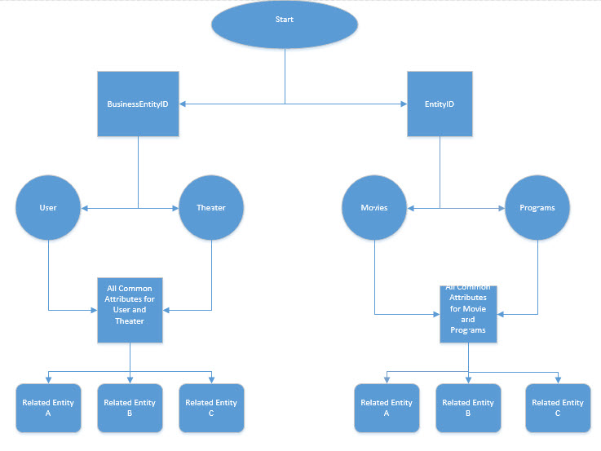
ER Model - (Entity Relationship )

Slide 6
Toad ER Model –Designing
Toad Model – An enhanced tool to design the entity relationship model for any RDBMS.
ER Model for IMDB

Slide 7
Database Implementations
SQL Server
Oracle
Hive

Slide 8
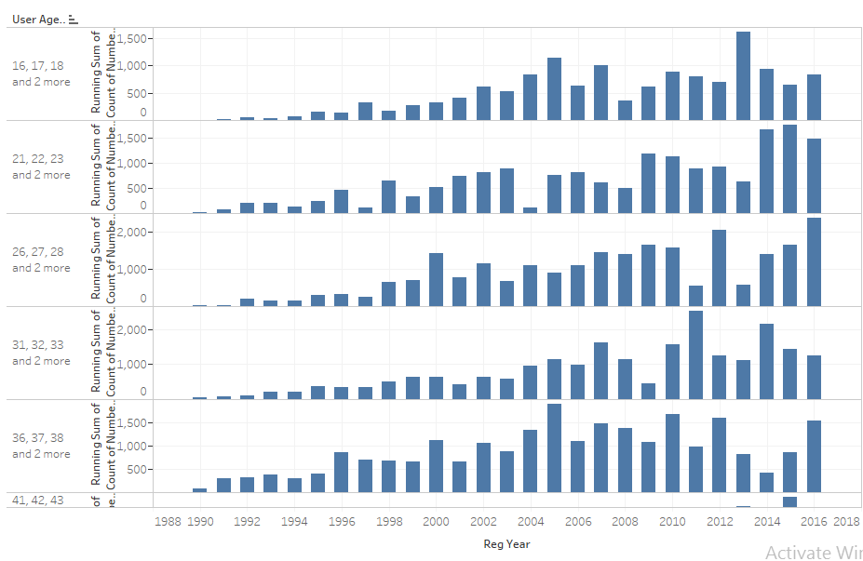
Application – Data Analysis (Tableau tool )
Overview: Tableau is an Interactive data visualization product focused on Business intelligence (BI).

Slide 9
Thank You ☺

